Slide 1
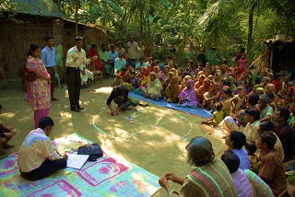
‘Can Social Cohesion be Harnessed to Repair Market Failures? Evidence from Group lending in Guatemala’
Author :Bruce Wydick
Presented by Iffat Ara Mustaque

Slide 2
Background
What is Group lending?
Instead of lending directly to individual borrowers, many credit institutions in developing countries have chosen to lend to self-selected groups of entrepreneurs who are jointly liable for a single loan. This method of credit delivery has become known as group lending, and has rapidly gained the attention of economists as one of the most innovative and promising means of making credit available to those without access to the formal financial market.
Why are economists so fascinated with group lending?
The fascination of economists with group lending is 2 fold: First has been the well-publicised success of several group lending institutions, especially that of the Grameen Bank in Bangladesh, founded in 1983 by Bengali economics professor Muhammad Yunus. Second is the manner in which group lending exploit social ties and the potential for peer monitoring and social pressure between borrowers to bridge the asymmetric information gap between lenders and borrowers in small-scale credit transactions. Part of the intrigue of group lending is that its apparent success gives rise to the question of whether it is possible to create small-scale institutions purposefully that are able to utilise a close network of relationships to mitigate asymmetric information problems in critical markets.
In other words, can social cohesion be harnessed to repair market failures?

Slide 3
Why is this question important to answer?
This question is currently of immense practical importance. In January 1997 world leaders gathered at the United Nations to agree on a plan to advance $21.6 billion to 100 million of the world's poor in the form of microenterprise loans over the next eight years. The stated goal of this agreement is to replicate the successes of the Grameen Bank and similar microenterprise credit institutions across the developing world. Since the Grameen Bank attributes much of its own success to its borrowing group technique, it is clearly important in this context for economists to understand how group lending actually works.

Slide 4
Literature Review
Recent research on group lending has argued that in the presence of imperfect information in the credit market, group lending allows for Pareto superior equilibria in credit markets. Ghatak (1995) argues that because group formation is determined through self-selection, groups tend to consist of borrowers homogeneous in quality. He shows then how this process decreases the fraction of risky borrowers in the lending pool, lowering the equilibrium interest rate and leading to a Pareto-superior outcome relative to individual lending.
The idea that self-selection of borrowers can improve the functioning of credit markets is supported by the empirical research of Wenner's (1995) study of 25 Costa Rican credit groups, where repayment performance was greater among groups able to engage in active screening of members.
A great deal of theoretical research on group lending posits that the performance of the institution is likely to be dependent on the strength of different types of social cohesion within borrowing groups. The work of Stiglitz (1990), Varian (1990), and Rashid and Townsend (1992), for example, emphasises the importance of peer monitoring in group lending :
Stiglitz shows that by transferring risk from the lender to borrowing groups, group lending is able to offer borrowers a loan contract that improves borrower welfare.
Varian concludes that group lending can be advantageous for lenders if group members can insure one another across states of nature that are unobservable to the lender.
Rashid and Townsend point that borrowing group performance should be sensitive to variables that affect the ability of members to monitor one another's investment behavior.
Besley and Coate(1995) place a particular emphasis on the need for social penalties against defaulting members in a borrowing group.
Other theoretical work, such as Floro and Yotopolous (1991), has tied the success of group lending to its ability to harness social ties between borrowers to improve loan repayment
Notes:
Other theoretical work, such as Floro and Yotopolous (1991), has tied the success of group lending to its ability to harness social ties between borrowers to improve loan repayment. Since there are negative externalities inØicted on other members of the community from individual default, and because borrowers' utility functions are presumably sensitive to changes in social standing in tightly knit communities, borrowers therefore internalise the externalities associated with moral hazard in credit contracts. According to this view, we should expect to see better borrowing group performance where social ties between members of borrowing groups are strong.
Besley and Coate (1995) place a particular emphasis on the need for social penalties against defaulting members in a borrowing group. They show that without the pressure of sanctions against a defaulting member, group loan repayment may be either higher or lower than that for individual loans. Wydick (1996) shows that a sufÆciently strong (and credible) threat of social sanctions against a defaulting group member produces a Nash equilibrium in which group lending is able to deter moral hazard in a credit contract. In this view, it is not strictly social ties between borrowers that curtail moral hazard by borrowers, but the strength of group pressure against potential defaulters which is a key determinant in group performance.

Slide 5
Objective of this research
While much research has theorised about how borrowing groups function, there has been little empirical testing to determine the relative validity of these differing views.
This paper presents an empirical test of the significance of three different types of social cohesion on borrowing group performance: peer monitoring, social ties between group members, and borrowing group pressure to repay loans.
The paper analyses the effect of these on the provision of intra-group insurance(where members help each other out), the mitigation of moral hazard(reduction of misuse of loans) within borrowing groups, and overall group repayment performance(measured by average no days the loan is in arrears).
The data used for testing the competing paradigms were obtained first- hand by the author in 1994 through a survey of 137 borrowing groups carried out in cooperation with a group lending institution in western Guatemala.

Slide 6
Group Lending in Western Guatemala- A Brief Overview
The group lending methodology of FUNDAP3 in western Guatemala uses many of the principles from the well-known Grameen Bank model, and operates in the following manner: a loan offcer assigned to a specific village introduces local small enterprise owners to the credit programme. Loan applicants self-select into groups consisting of three to eight members. The group applies for a single loan which is quite small initially, perhaps as little as $200±$500, to be paid in monthly installments over the course of 2 to 6 months. Although the loan is divided between members for investment in their own enterprises, all group members are jointly liable for loan repayment. As a consequence, group members have an incentive to apply pressure to any member who fails to make timely payments. This pressure can range from mild admonishments to repay to the more serious threat of expulsion from the group and this carries pecuniary as well as social penalties, since those kicked out of borrowing groups are not eligible to receive further loans from FUNDAP
FUNDAP achieved operational self-sufficiency only a few years after its foundation in 1988, and is reliant on outside sources of capital only for expanding operations. This success has been due in large measure to the high repayment rate with its group loans. The repayment rate for FUNDAP's group loans is approximately 97%, a figure that is routinely several percentage points higher than the repayment rate on its individual loans offered to borrowers with slightly larger enterprises.

Slide 7

Fieldwork and Empirical Testing
The author carried out a survey of 137 of FUNDAP's borrowing groups in western Guatemala, primarily in and around the rural and urban towns of Quetzaltenango and Totonicapan. Table 1 provides description statistics of all variables used in this estimation.
A bivariate logit model was used to generate maximum likelihood estimates of the effects of these measures of social cohesion in reducing moral hazard by group members, the provision of intra-group insurance, and the overall group repayment performance to the loan institution.
The logit estimators are of the form
x1's are a set of T=4 variables that are intended to measure social ties between group members, the x2's are a set of P=5 variables that measure group pressure for repayment, the x3's are a set of M=3 variables that refect the level of peer monitoring within a borrowing group, and the z3's are a set of C=3 control variables which include a group's alternate access to credit, and P j are the three dependent variables representing probabilities of the absence of risky borrower behaviour within a group, the provision of intra-group insurance, and group loan repayment performance.

Slide 8
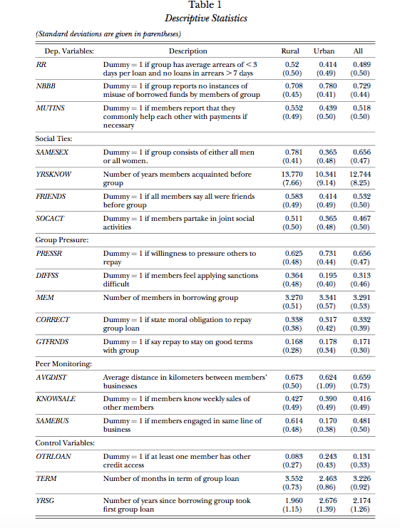
Table 1 provides descriptions and descriptive statistics on all variables used in the estimation
Notes:
RR- measures repayment rate
NBB- measures moral hazard
Mutins- Mesures provision of intra group performance
Explain independent
Foe example one of the things we we r tring to see if pressure on group members is reducing moral hazard by seeing whether group pressure is reducing misuse of borrowed of funds or whether group pressure is reducing repayment rate by reducnig the no. of days the loans is in arrears.

Slide 9
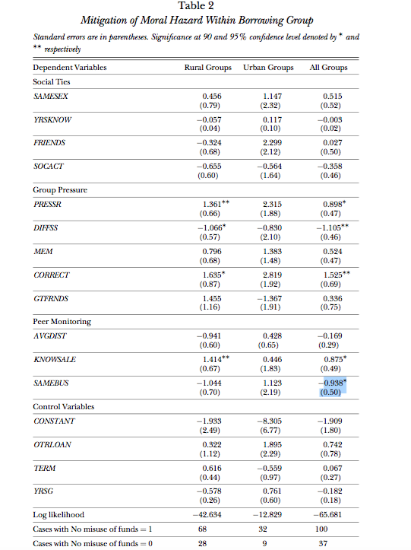
The first logit estimates show the effect of the independent variables on the mitigation of risky borrower behaviour/Moral Hazard. In these estimates, the left-hand-side variable was equal to one if groups reported no instances of misused loans in the history of their borrowing group.
The contrast between the rural groups and urban groups in the estimation is noteworthy. In urban groups, group pressure appears to have little effect on borrower behaviour. In rural areas, however, a willingness to apply group pressure repay (PRESSR=1) has a significant effect on reducing moral hazard within borrowing groups.
In addition, when rural borrowers indicate that sanctioning another member of their group would be difficult (DIFFSS=1), the probability of misuse of funds increases as seen by the negative relationship.
The signficance of CORRECT indicates that the moral obligation of group loan repayment is also important in rural groups. What is also noteworthy about the estimates of moral hazard is the almost total absence of significance of variables reflecting social ties within borrowing groups.
Notes:
In table 2, we have the results fr how social cohesion reduces moral hazard
Positive relationship- this reduces moral hazard
Negative relationshio-this increases. Dummy 1 and 1

Slide 10
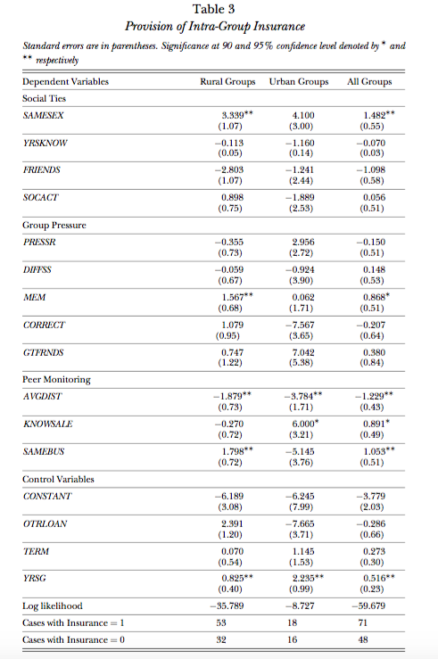
For the estimates of intra-group insurance presented in Table 3, the left- hand side dummy variable was equal to one if the group indicated that its members at least occasionally help other members with their loan payments when they are in need.(provision of intra group insu).
The results in Table 3 reveal the central importance of peer monitoring in the provision of intra-group insurance. In urban areas, KNOWSALE is significant at the 90% level, and AVGDIST is significant at the 95% level in explaining insurance provision. In rural areas, AVGDIST and SAMEBUS which facilitate monitoring are both significant at the 98% level

Slide 11
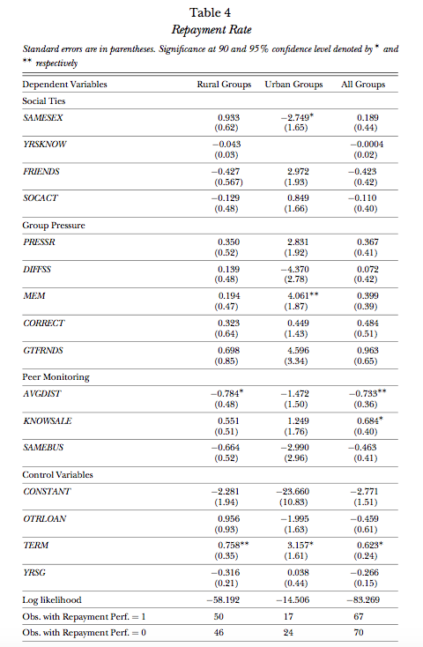
The final logit estimation, presented in Table 4, shows the effect of the theoretically significant variables on the overall group repayment performance.
A group received a dummy variable equal to one if they were by FUNDAP's own criteria, a `problem-free' group. These groups had never been more than seven days late with any loan, and had average arrears of less than three days per loan.
The estimation reveals the importance of peer monitoring with respect to group loan repayment. AVGDIST and KNOWSALE are again significant, via their effect on facilitating intra-group insurance. Again, there is no clear pattern of significance with variables intended to reflect the degree of social ties in borrowing groups or group pressure.

Slide 12
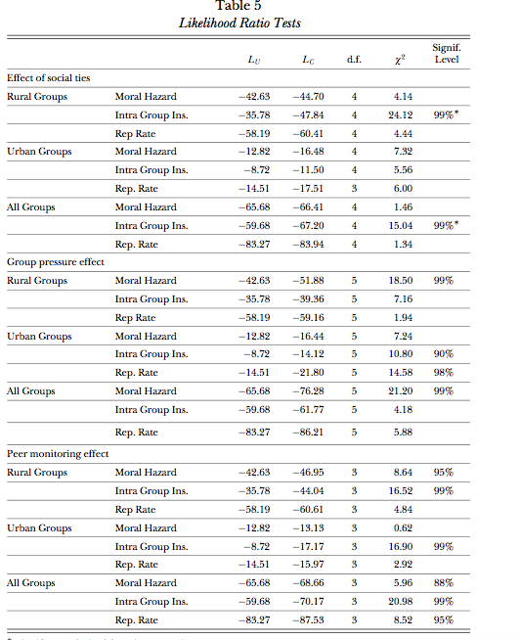
The final empirical task was to test the overall significance of the three different types of social cohesion on the Guatemalan data. To carry out this procedure likelihood-ratio tests were performed on the logit estimates.
The results of the likelihood ratio tests on the Guatemalan data offer evidence that the success of group lending is derived from peer monitoring and a group's willingness to apply internal pressure on delinquent members rather than the institution's ability to harness previously existing social ties to improve loan repayment.
Of the three different measures group performance through a moderate effect on mitigating moral hazard problems, and through a stronger effect on facilitating intra-group insurance. The effect of group pressure is observable, but more limited
Notes:
First the unconstrained logits were estimated, then constraints were placed by sequentially constraining to zero the set of coefficients representing the three different types of social cohesion. The likelihood ratio, given in log form as 2(log I C log I U ) ⇠ ̃2k , follows a chi-square distribution with k degrees of freedom, where k is the number of restricted parameters, LC is the constrained log-likelihood value, and LU is unconstrained.

Slide 13
Conclusion
One of the central findings of this research is the surprisingly small degree to which social ties within borrowing groups affect group performance. In the estimates from Guatemalan data, social ties either show no significant effect on borrowing group behaviour
In the Guatemalan context, group lending does not appear to function through utilising previously existing social ties to mitigate moral hazard problems, facilitate credit insurance, or improve repayment rates.
Moreover, both first-hand observation of borrowing groups and the empirical results of this research suggest an alternative view of borrowing groups: Via peer monitoring, borrowing groups appear to function both as miniature insurance networks (as in Rashid and Townsend, 1992) and as juries, helping those with verifiable claims of hardship to repay loans, while threatening indolent and risky borrowers with expulsion from the group
A credible promise by the institution to deny credit to expelled group members provides the backbone for judgments rendered by groups upon the performance of their individual members. If borrowing groups indeed function in this way, previously existing social ties are unnecessary for group lending to yield high repayment rates. Previously existing social ties may even create a conflict of interest for borrowing groups, making threats of expulsion from the group more difficult and less credible.
A second finding of this research is that groups located in different settings appear to enforce repayment within their membership in different ways: Repayment rates are improved in urban groups primarily though the stimulation of intra-group insurance via more intensive peer monitoring. For groups located in rural areas, where direct monitoring is difficult, moral hazard is deterred primarily through a willingness to apply social pressure

Slide 14
Some Policy implications of this research
Group lending may not need to be implemented in areas in which social ties are strong for the institution to be able to reduce problems related to asymmetric information in credit markets. The conclusions from this research suggest that the performance of group lending as an institution is more likely to be influenced by the ability of borrowers to monitor one another and the ability of borrowing groups to credibly threaten to sack poorly performing members from the group. This finding underscores the importance many group lending institutions give to training sessions in which groups are given permission, and even encouraged, to drop members from their ranks who are habitually tardy with payments,and to come to the aid of borrowers who have been victims of unavoidable mishap. In this way, borrowing groups can function through a form of social cohesion that may operate independently of previously existing social ties

